Slide 1
EE232: Lightwave Devices
Prof: Ming Wu
GSI: Kevin Han
Discussion 1/17/18

Slide 2
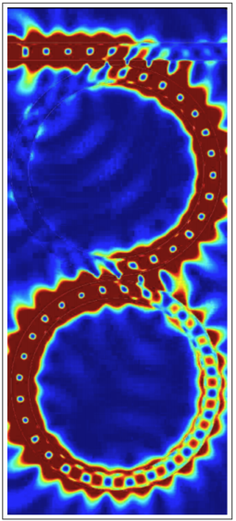
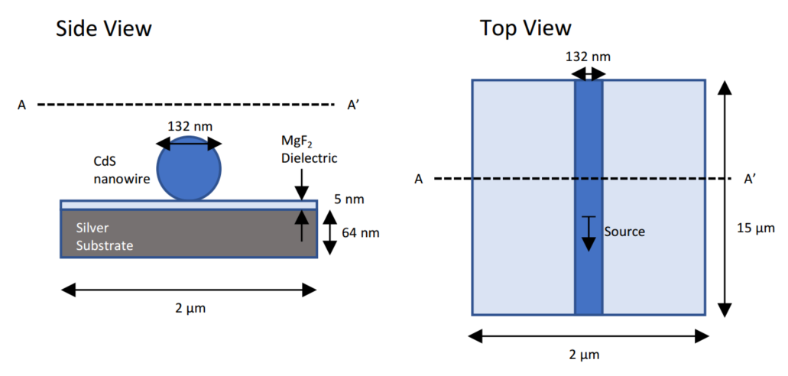
EE232 overview
Lectures will mainly cover lasers and detectors
Discussions will mainly cover other photonic devices – waveguides, couplers, modulators
Lumerical FDTD and related applications will be used throughout discussion and for final project
Dual microring resonator
CdS nanowire laser
Notes:
Unusual plasmonic laser structure

Slide 3
Today: intro to FDTD
General FDTD simulation and E&M concepts
Example: DVD reader

Slide 4
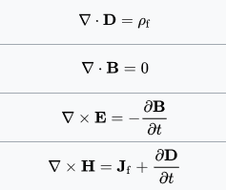
General simulation concepts
The finite-difference time domain (FDTD) method simulates Maxwell’s equations in the time domain:
Constitutive relations:
Pros: easy to implement, covers wide frequency range in single simulation, can handle most material types
Cons: meshing can be tricky, large simulations difficult
Can extract far field using post-processing

Slide 5
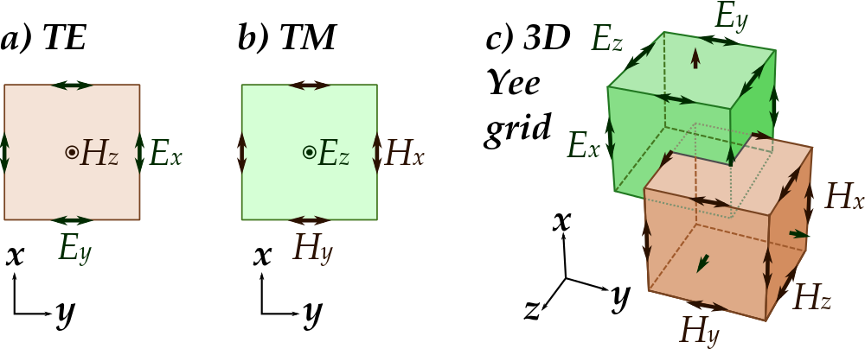
General simulation concepts
FDTD evaluates Maxwell’s equations on a grid, eg.
(Faraday’s law)
…
Source: Wikipedia

Slide 6
General simulation concepts
Radiation
Object
Source

Slide 7
General simulation concepts
Computational domain
Radiation
Object
Source
Truncation boundary

Slide 8
Boundary conditions
Perfectly matched layer (PML)
Computational domain
Radiation
Object
Source

Slide 9
Perfectly matched layer (PML)
Artificial material that absorbs radiation without reflection
This is perhaps the most common way to truncate a computational domain.
Disadvantages:
Some reflections from PML can occur. This can be minimized by ensuring that radiation hits PML at a 90 degree angle; i.e. place PML far from any scatterer or use circular computation domain if possible
Magnitude of reflections is wavelength dependent
Additional computational complexity: PML needs to be meshed and the fields need to be solved in this region

Slide 10
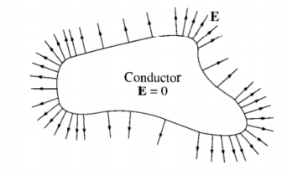
Other boundary conditions
Perfect electrical conductor (PEC): All radiation is reflected
Perfect magnetic conductor (PMC): Less common
Periodic boundary condition: Used for periodic structures. Need only simulate a unit cell.
Source: Griffiths, Intro to Electrodynamics

Slide 11
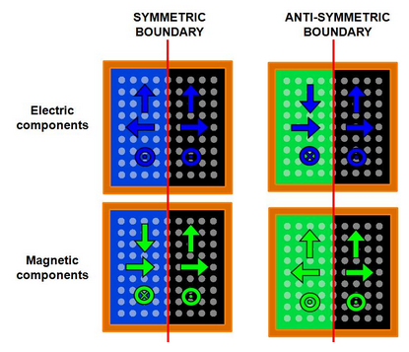
Other boundary conditions
Symmetric and anti-symmetric boundary: used when simulation has a mirror symmetry, to reduce simulation time by factor of 2, 4, or 8

Slide 12
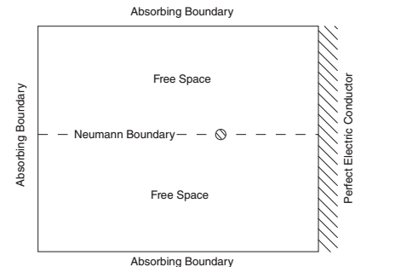
Example
Line current source
Source: Jianming Jin, “Theory and Computation of Electromagnetic Fields”

Slide 13
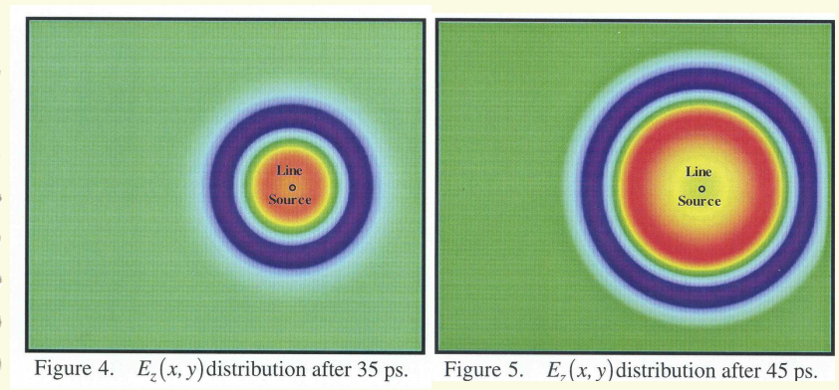
Source: Jianming Jin, “Theory and Computation of Electromagnetic Fields”

Slide 14
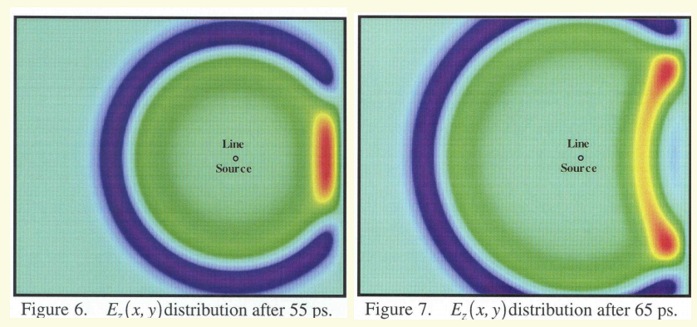
Source: Jianming Jin, “Theory and Computation of Electromagnetic Fields”

Slide 15
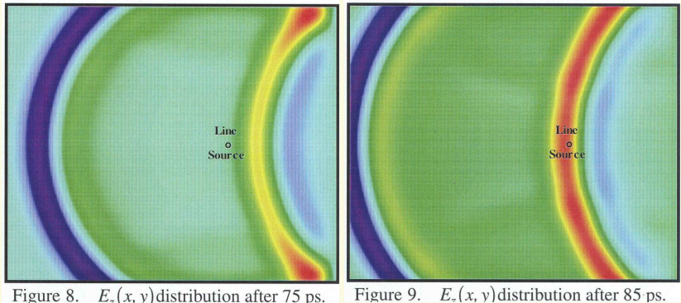
Source: Jianming Jin, “Theory and Computation of Electromagnetic Fields”

Slide 16
FDTD code implementation for previous example
for n=1:1:timesteps
Jz(src_X,src_Y)=exp(-0.5*(((n-1)*delt)/(2*period))^2)*sin(omega*(n-1)*delt);
%Size of grids
%Bx,Hx M rows, N-1 columns
%By,Hy M-1 rows, N columns
%Dz,Ez M rows, N columns
%Magnetic flux (Bx, By)
Bx(1:M,1:N-1)=(1./beta_y(1:M,1:N-1)).*(alpha_y(1:M,1:N-1).*Bx_negt(1:M,1:N-1)-...
(epsilon/dely)*(Ez_negt(1:M,2:N)-Ez_negt(1:M,1:N-1)));
By(1:M-1,1:N)=(1./beta_z(1:M-1,1:N)).*(alpha_z(1:M-1,1:N).*By_negt(1:M-1,1:N)+...
(epsilon/delx)*(Ez_negt(2:M,1:N)-Ez_negt(1:M-1,1:N)));
%Magnetic field intensity (Hx, Hy)
Hx(1:M,1:N-1)=(1./beta_z(1:M,1:N-1)).*(alpha_z(1:M,1:N-1).*Hx_negt(1:M,1:N-1)+...
(1/mu)*beta_x(1:M,1:N-1).*Bx(1:M,1:N-1)-...
(1/mu)*alpha_x(1:M,1:N-1).*Bx_negt(1:M,1:N-1));
Hy(1:M-1,1:N)=(1./beta_x(1:M-1,1:N)).*(alpha_x(1:M-1,1:N).*Hy_negt(1:M-1,1:N)+...
(1/mu)*beta_y(1:M-1,1:N).*By(1:M-1,1:N)-...
(1/mu)*alpha_y(1:M-1,1:N).*By_negt(1:M-1,1:N));
%Electric flux (Dz)
Dz(2:M-1,2:N-1)=...
(1./beta_x(2:M-1,2:N-1)).*(alpha_x(2:M-1,2:N-1).*Dz_negt(2:M-1,2:N-1)...
+(epsilon/delx)*(Hy(2:M-1,2:N-1)-Hy(1:M-2,2:N-1))...
-(epsilon/dely)*(Hx(2:M-1,2:N-1)-Hx(2:M-1,1:N-2))-epsilon*Jz(2:M-1,2:N-1));
%Electric field intensity (Ez)
Ez(2:M-1,2:N-1)=...
(1./beta_y(2:M-1,2:N-1)).*(alpha_y(2:M-1,2:N-1).*Ez_negt(2:M-1,2:N-1)...
+(1/epsilon)*beta_z(2:M-1,2:N-1).*Dz(2:M-1,2:N-1)...
-(1/epsilon)*alpha_z(2:M-1,2:N-1).*Dz_negt(2:M-1,2:N-1));
%Apply Etan=0 B.C
Ez(1:M,25)=0;
%Update field components
Ez_negt=Ez;
Hx_negt=Hx;
Hy_negt=Hy;
Dz_negt=Dz;
Bx_negt=Bx;
By_negt=By;
< 50 lines of MATLAB code!

Slide 17
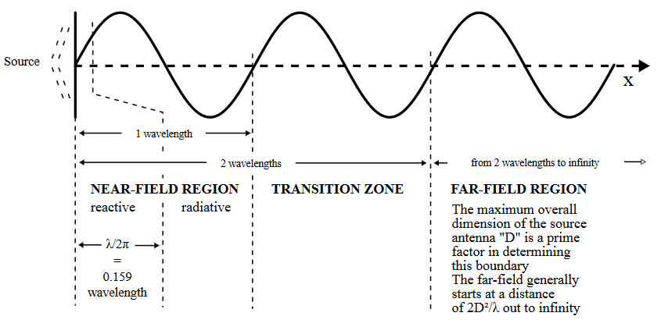
Propagating to far-field
FDTD can generally only simulate near-field effects due to need to mesh entire region
Often we are interested in the fields far away from simulation ($r≫λ$)
Source: Wikipedia

Slide 18
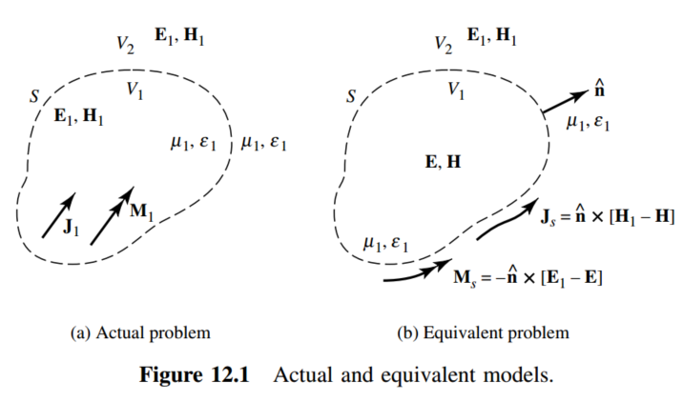
Propagating to far-field
Can calculate far-field using equivalence principle:
Pick a closed surface enclosing sources
Run simulation and record fields on surface
Replace fields on surface with equivalent current sources
Use radiation equations to determine E₁, H₁ fields in far-field
Vector potential A
Current source J
Can pick to be zero
Source: Balanis, Antenna Theory

Slide 19
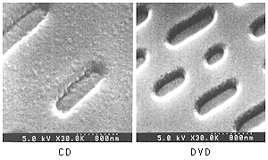
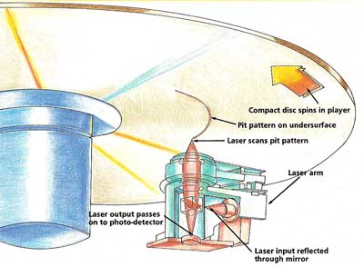
How a DVD works
Basic idea: Laser is scanned over DVD. If laser beam encounters pit the light
will be scattered away and will not reach the photodetector (Binary 1). Otherwise,
most laser light is reflected back toward the photodetector (Binary 0).
Source: http://functionalcd.weebly.com/

Slide 20
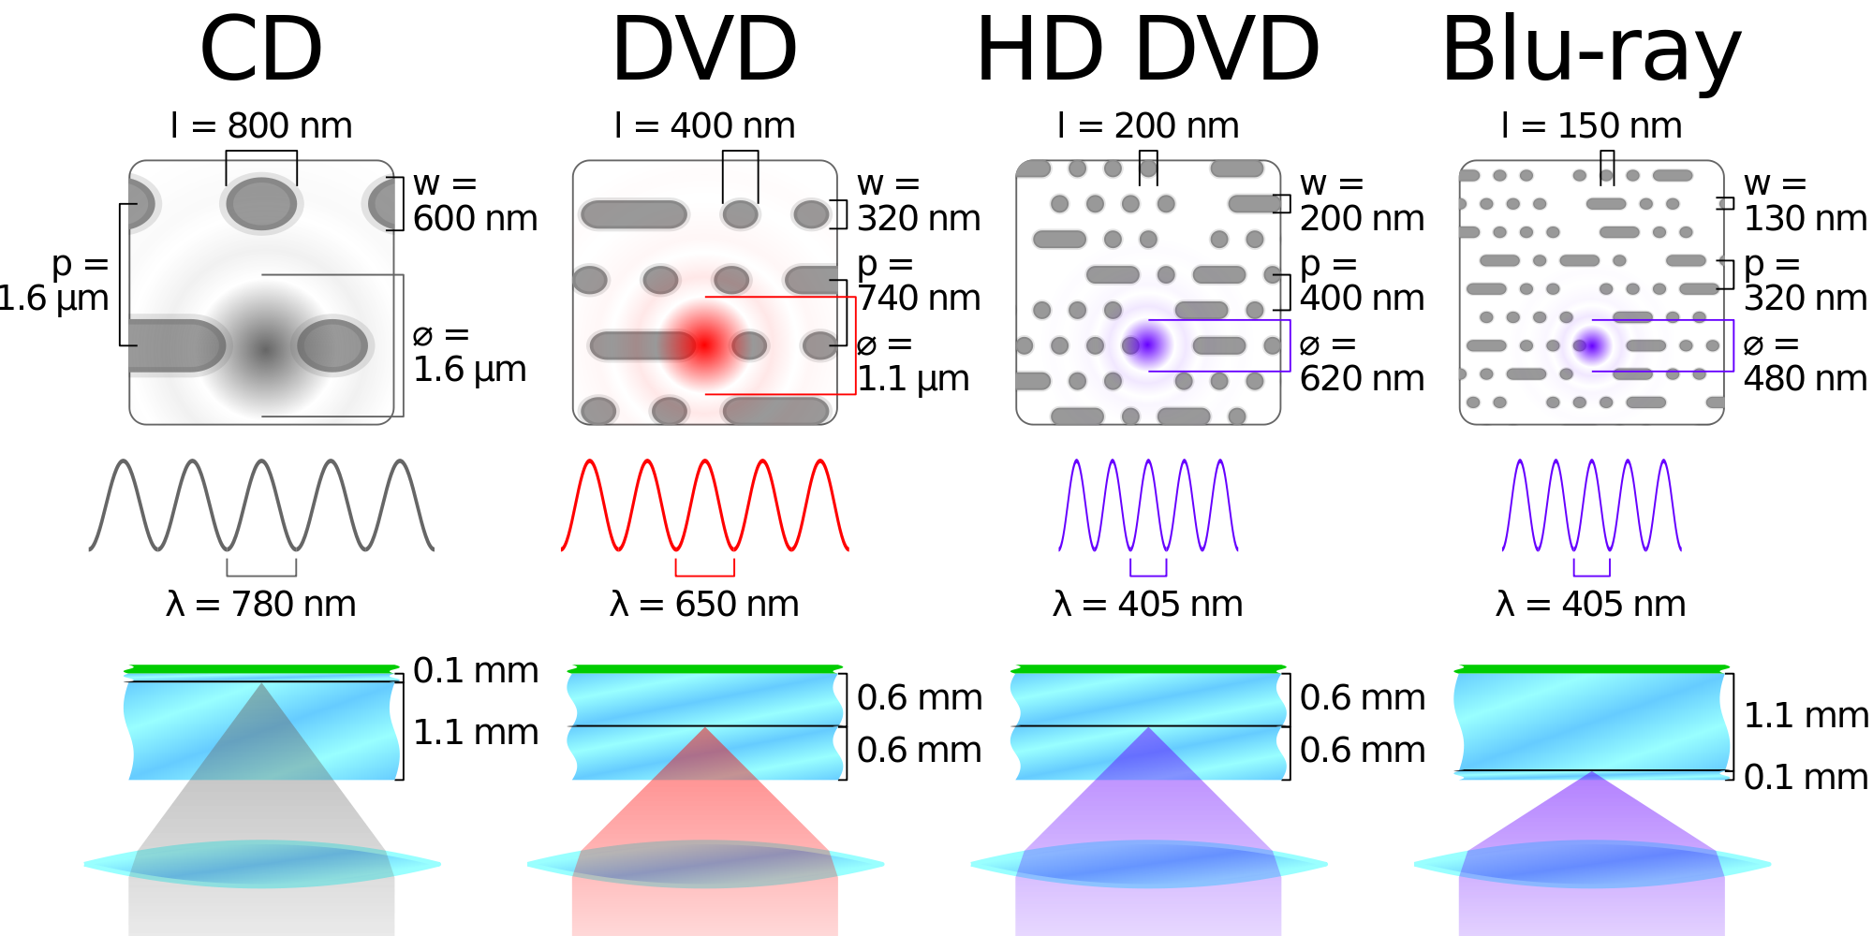
How a DVD works
Source: Wikipedia

Slide 21
FDTD simulation
Polycarbonate (n=1.55)
Using Lumerical FDTD, we would like to optimize the dimension of the “pit” such that we maximize the amount
of laser light scattered.
PML
We will assume focused Gaussian spot for 650nm laser.
PML / PEC boundary conditions will be utilized to truncate the computational domain.
We will use FDTD to calculate the far-field light radiation
scattered by the pit.
Laser
650nm
PML
PML
320nm
120nm
pit
land
PEC
Aluminum

Slide 22
Next time
Install Lumerical FDTD Solutions
Walk-through creating and running simulation of DVD pit
Analyze results
Investigate modifying pit height

